Slide 1

Asthma and air pollution
Bodorkós Gellért 2021

Slide 2
Asthma is a chronic lung disease that is caused by inflammation and an overreaction of the immune system
The prevalence of asthma in the adult population is on a global average approximately 1 adult in every 13
Symptoms can be episodes of wheezing, coughing, chest tightness, and shortness of breath.

Slide 3


Slide 4


Slide 5
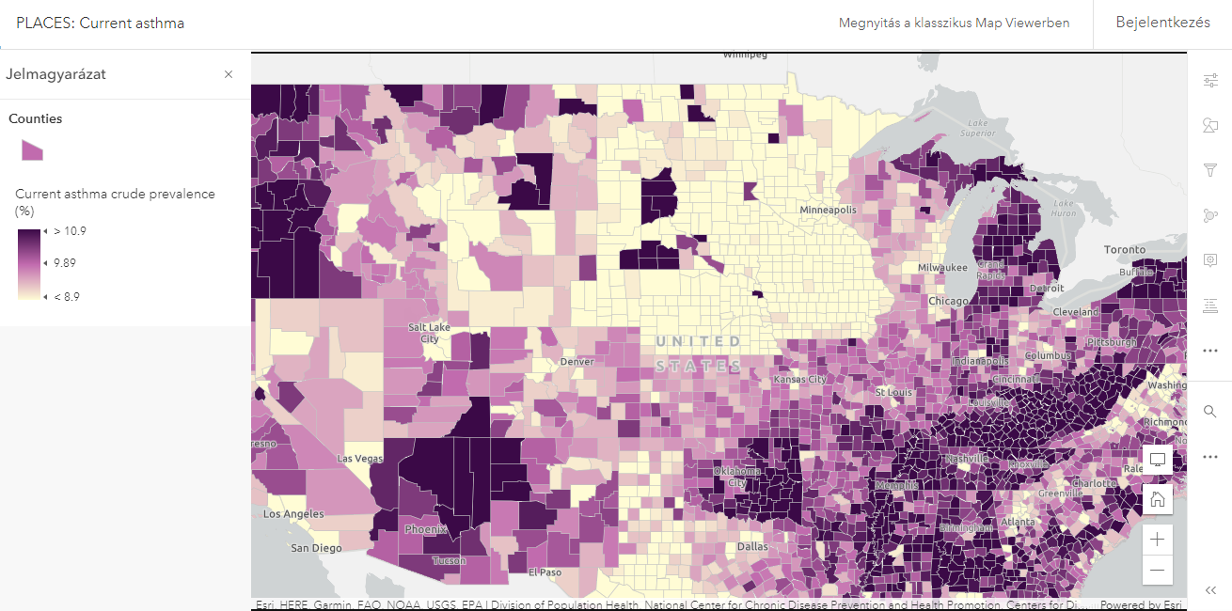

Slide 6
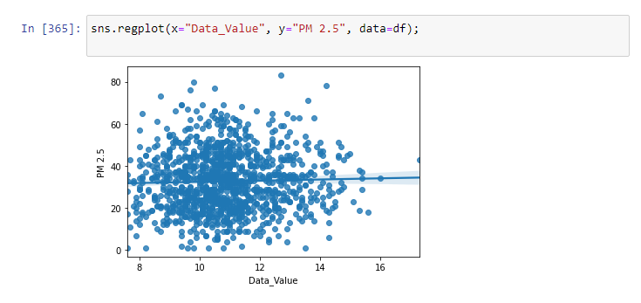
Regplot of the first dataset
Linear regression, R2 score: -0.0035139031879378724
KNN train R2: -0.12462578992108986
test R2: -0.29514874524476453

Slide 7
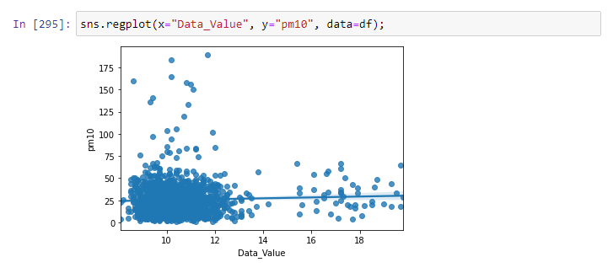
Regplot of the second dataset
Linear regression, R2 score: -0.0009465542314992526
KNN train r2: -0.04530130949232336
test r2: -0.2553391688997235

Slide 8
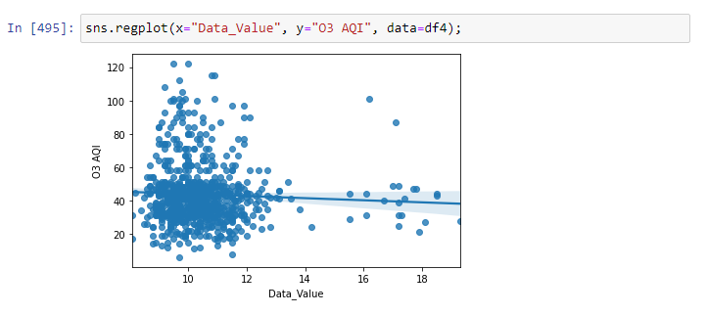
Regplot of the third dataset:
Linear regression, R2 score: -0.11770285293444727
KNN train r2: 0.20935753415544
test r2: -0.96931486402670517
Random forest: train r2: 0.8365651368577988
test r2: -0.15212262217992523

Slide 9
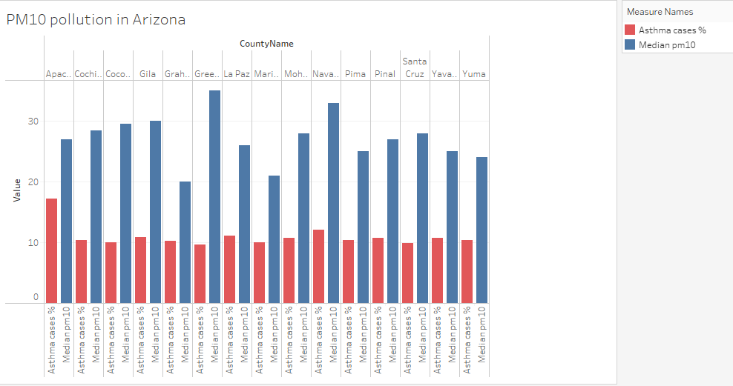

Slide 10
